Slide 1
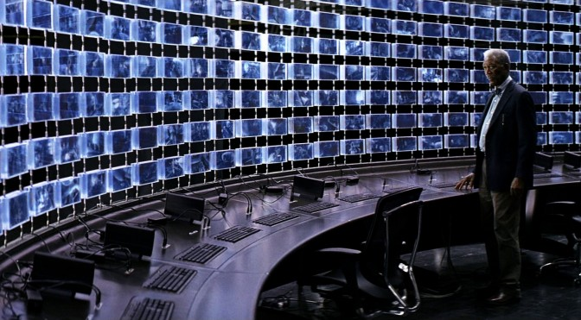

CSAFE Field Update
Considering Ethical Implications of Algorithms Require Critical Evaluations
Source: Dark Knight Rises
Sarah Chu • Sr. Advisor on Forensic Science Policy • June 14, 2021

Slide 2

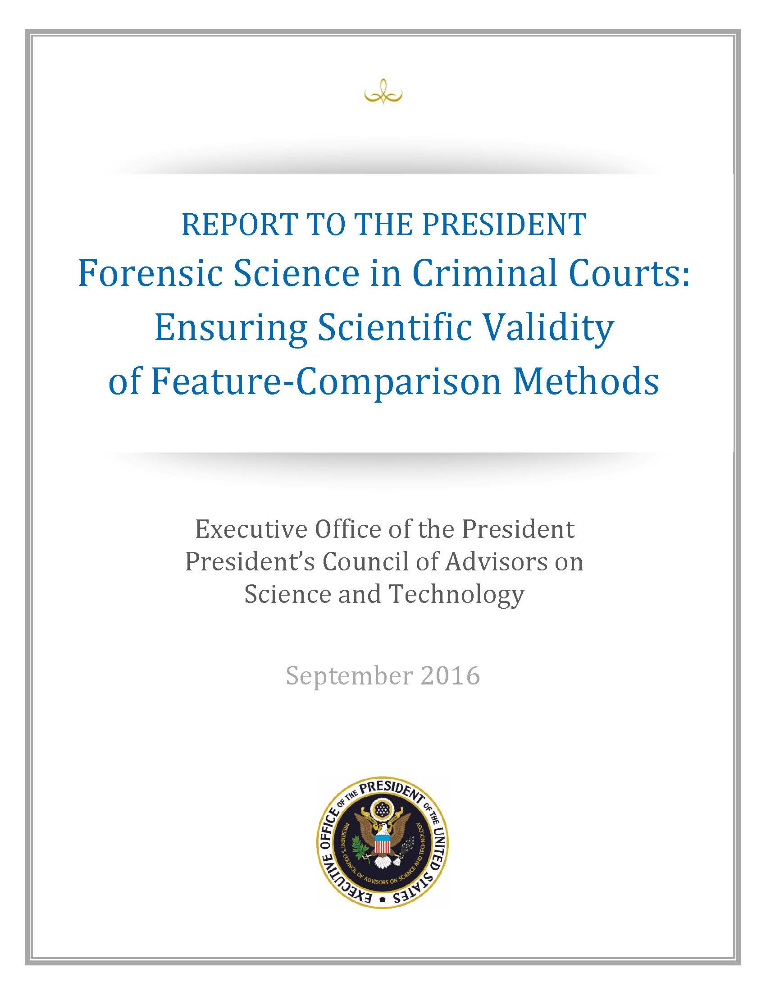
Notes:
For those of us in this space, validity and reliability have been our key focus in our efforts to address challenges in forensic science.

Slide 3
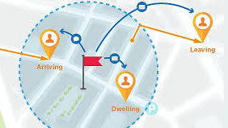


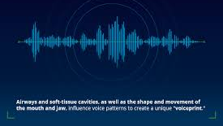
Geofencing
Facial Recognition
Predictive Algorithms
Speaker Recognition
Notes:
Now we are faced with algorithms and AI technologies that have been dangerously flawed…but what do we do if they get better?

Slide 4

Notes:
Here Lucius Fox is confronted with a highly accurate and reliable technology and his concern is not about whether or not it works, but he asks, “at what cost?”

Slide 5
The justice and equity implications of algorithms matter as much as their validity and reliability.
Notes:
To answer that question, I’ll state my primary thesis.

Slide 6
A case in point…

Slide 7

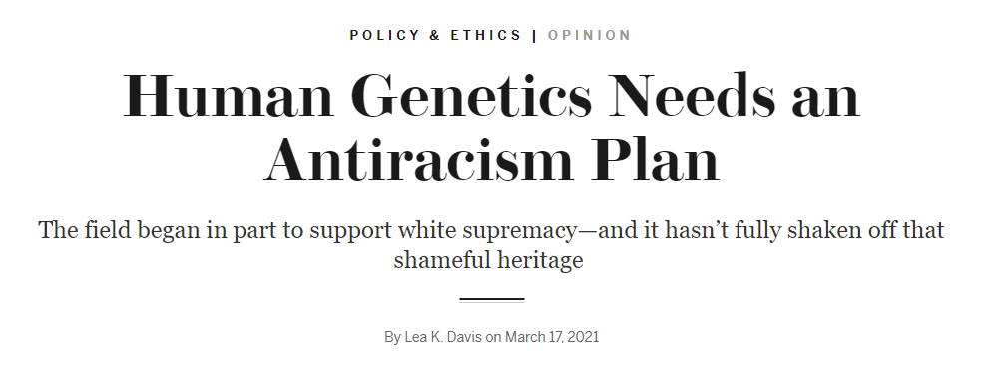
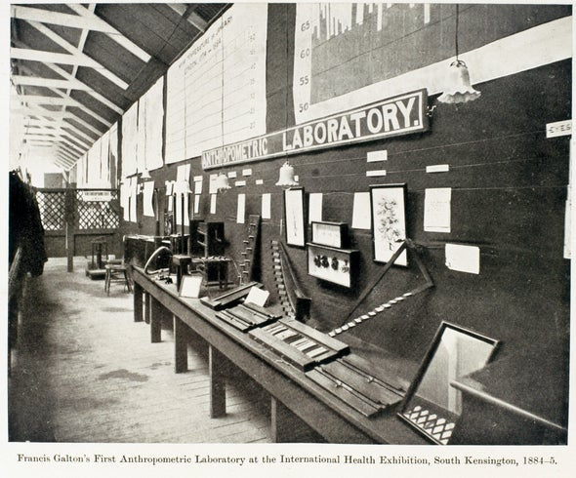
Eugenics linked genetics to race and connected social traits.
U.S. Eugenic Record Office became an “analytical index of traits in American families” (Allen, 1986)
U.S. Eugenic Record Office contributed to policies:
Virginia Racial Integrity Act
Eugenical Sterilization Act
Disenfranchising racial minorities, immigrants, poor white populations
Notes:
Francis Galton coined the term Eugenics. In forensics, we hear Galton and we think fingerprints, but he was also known as the scientist who initiated the study of eugenics.
The US had a US Eugenics Record Office based at another familiar name – Cold Spring Harbor. This office was considered cutting edge.
US ERO research inspired Nazi eugenics research.
1910-1939 – closed because of discomfort with Nazi use of eugenics.

Slide 8

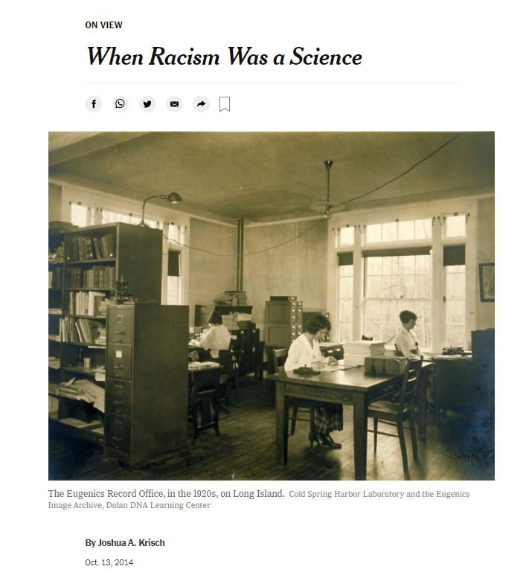
“The Eugenics Record Office was built around very systematized ideas that still might be seen as legitimate today,” said Noah Fuller, an artist and co-curator of the exhibit. “At the time, this was widely accepted as legitimate science.”
Notes:
What other tools do we consider legitimate and widely accepted today?

Slide 9
How did the use of eugenics gain legitimacy?
How was it deemed valid?
Why didn’t people question its use?
Notes:
Answer: Users weren’t interested.
Remember, the people targeted by the eugenics database were those out of power: racial minorities, immigrants, poor white populations. They were the groups of people who were least able to push back on the orthodoxy of science.

Slide 10


Criminology of the Other
(Garland, 2001)
Notes:
In social science, this phenomena is called criminology of the other. It was described by David Garland in the “Culture of Control”:
“There is a criminology of the other, of the threatening outcast, the fearsome stranger, the excluded and the embittered. One is invoked to routinize crime, to allay disproportionate fears and to promote preventative action. The other functions to demonize the criminal to put act popular fears and resentments, and to promote support for state punishment.” (Garland, 2001)
When we can separate ourselves from the people upon whom the algorithms will be used, we can separate ourselves from the harms or consequences that might come from them because they are not us.

Slide 11
“Future research needs to be aimed at examining both access to prevention technologies and techniques and whether different subpopulations are bearing the negative impact of prevention technologies in society more than others.”
(Hollis, 2019)
Notes:
In a commentary on a systematic review of CCTV studies, Megan Hollis writes:

Slide 12
1. Ethical, Legal, and Social Implications (ELSI) is an area of study.

Slide 13

Established in 1993
James Watson called for NIH to establish a research program to address issues raised by rapidly advancing field of DNA
Congress mandated that “not less than” 5% of budget be set aside for ethical, legal, and social implications (ELSI) research
(Hanna, 1995; McEwen et al., 2014)

Slide 14
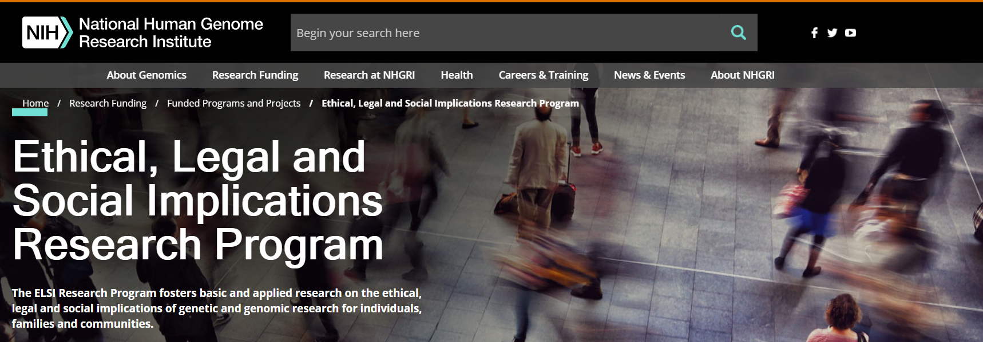
to anticipate and address the implications of the HGP for individuals and society
to identify and define the major issues of concern and develop policy options to address them
(Meslin et al., 1997)

Slide 15
ELSI Research Priorities (1997)
privacy and fairness in the use and interpretation of genetic information
clinical integration of new genetic technologies
issues surrounding genetics research
public and professional education
(Meslin et al., 1997)

Slide 16
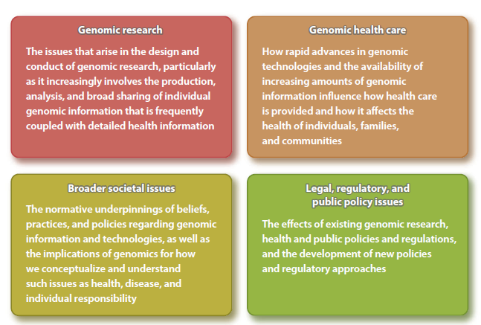
ELSI Research Priorities (2014)
(McEwen et al., 2014)
Notes:
…but ELSI has failed to fully address the structural racism that has been at the historical core of genetics research and the use of genetic databases.
Where do we go from here?

Slide 17
2. ELSI is not enough! We need to think critically about algorithms.
Notes:
Tech design is part of the problem. We know that it is implicated by testing (what databases are being used), degrees of validation, homogenous designers who embed code with their biases, use of measures that reflect the normative binary way we think about criminal justice: guilty/innocent, match/no match.

Slide 18
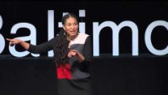
Notes:
Ruha Benjamin, a Princeton sociologist who focuses on the relationship between innovation and equity, particularly focusing on the intersection of race, justice and technology. This is an excerpt from a Ted Talk where she discusses discriminatory design in the context of biotechnology.

Slide 19
“The only way to keep an entire group of sentient beings in an artificially fixed place, beneath all others and beneath their own talents, is with violence and terror, psychological and physical, to preempt resistance before it can be imagined. Evil asks little of the dominant caste other than to sit back and do nothing. All that it needs from bystanders is their silent complicity in the evil committed on their behalf, though a caste system will protect, and perhaps even reward, those who deign to join in the terror.”
-Isabel Wilkerson, Caste

Slide 20
What is a critical approach to technology?
Technology is not neutral, but a product of the social and political forces that produced it
Technology has normative implications on dimensions of power and inequality that need to be evaluated.
In the criminal legal system, the foremost inequalities that are reproduced by technology involves race.
Whose agenda is being reproduced?
Who benefits and who is harmed?
(Grimes and Feenberg, 2013)

Slide 21
3. Technology design needs to be reimagined.
Notes:
Tech design is part of the problem. We know that it is implicated by testing (what databases are being used), degrees of validation, homogenous designers who embed code with their biases, use of measures that reflect the normative binary way we think about criminal justice: guilty/innocent, match/no match.

Slide 22
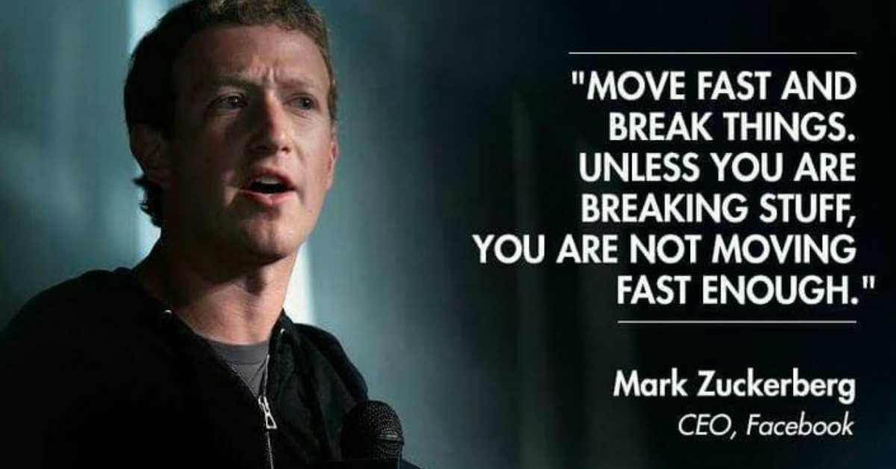
Notes:
But what if moving fast and breaking things…broke people? We haven’t been able to rely on the tech developers in the past because their culture wasn’t oriented to thinking about long term implications of their technologies. Apps, software, algorithms are released quickly and bugs are resolved through updates or forgotten after the next great app comes around. The problem is that in the criminal legal system, someone has been harmed or a case has been impacted before the problem is discovered. We don’t have a system designed to look back at old versions of software and redress the harm that could hve been produced.

Slide 23
Part of our role as citizens is to look more closely at the media surrounding us and think critically about its effects—specifically, whose agenda is being promoted and whether it’s the agenda that will serve us best.
― Jonathan Taplin, Move Fast and Break Things: How Facebook, Google, and Amazon Cornered Culture and Undermined Democracy
Notes:
Whose agenda is served by fast implementation of technologies?
Who is harmed by fast implementation of technologies?

Slide 24
Community Technology Oversight Boards
Technologists
Sociologists
Critical Scholars
“Trinity”
Practitioners
Researchers
Community Stakeholders
Phase 1
Problem Identification
Technology Selection
Phase 2
Evaluation
Phase 3
Retooling
Phase
Authentic democratic
engagement
Launch Study
Identify barriers
Integrate feedback
Finalize and publish SIA
or, revise/return to Phase 2
Long-term monitoring
Surveillance Impact Statement (SIA)
Establish social justice and crime reduction metrics
Police
Prosecutors
Public Defenders
Public Interest Groups
Affected Communities
Software& Version
Updates
Duty to
Correct & Notify
(Piza, E., Chu, S., and Welsh, B., forthcoming)
Notes:
Tawana Petty “experts of our circumstance”

Slide 25
A New Paradigm
Forensic Method or Technology
Scientific Metrics
Justice & Equity
Metrics
Community Engagement
Transparency
Equality of Access
Duty to Correct and Notify

Slide 26

Photo Credit: The Mandolorian

Slide 27
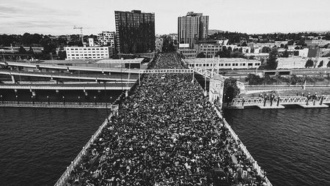
Meeting the moment
Photo credit: Andrew Wallner
Notes:
Burnside Bridge protest in Portland on June 2, 2020
Thousands of people laid down... for 8 minutes and 46 seconds in remembrance of George Floyd,

Slide 28
10 simple rules for responsible big data research:
Acknowledge that data are people and can do harm
Recognize that privacy is more than a binary value
Guard against the reidentification of your data
Practice ethical data sharing
Consider the strengths and limitations of your data; big does not automatically mean better
Debate the tough, ethical choices
Develop a code of conduct for your organization, research community, or industry
Design your data and systems for auditability
Engage with the broader consequences of data and analysis practices
Know when to break these rules
(Zook et al., 2017)

Slide 29
How it matters
NIST DNA mixture report should cause us to rethink how PG results are reported, interpreted, caveats
LRs give degrees of inclusion – what if we did degrees of exclusion?
Lower standards for investigative techniques
Duty to correct and notify
What investments are being made into the databases that are used to validate algorithmic technologies
What information is being publicly shared about validation studies? TO what degree are valiation studies being done?

Slide 30
Concern for man and his fate must always form the chief interest of all technical endeavors. Never forget this in the midst of your diagrams and equations.
- Albert Einstein
(New York Times, 1931)

Slide 31
References
Allen, G. E. (1986). The Eugenics Record Office at Cold Spring Harbor, 1910-1940: An Essay in Institutional History. Osiris, 2, 225–264. https://doi.org/10.1086/368657
Davis, L. K. (n.d.). Human Genetics Needs an Antiracism Plan. Scientific American. Retrieved May 2, 2021, from https://www.scientificamerican.com/article/human-genetics-needs-an-antiracism-plan/
Elderbroom, B., Bennett, L., Gong, S., Rose, F., & Towns, Z. (2018). Every Second: The Impact of the Incarceration Crisis on America’s Families (p. 54). FWD.us. https://everysecond.fwd.us/downloads/EverySecond.fwd.us.pdf
Garland, D. (2001). The culture of control: Crime and social order in contemporary society. University of Chicago Press.
Hanna, K. E. (1995). The Ethical, Legal, and Social Implications Program of the National Center for Human Genome Research: A Missed Opportunity? In R. E. Bulger, B. E. Meyer, & H. V. Fineberg (Eds.), Society’s Choices: Social and Ethical Decision Making in Biomedicine. National Academies Press.
James, D. J. (2004). Profile of Jail Inmates, 2002 (p. 12). Bureau of Justice Statistics, Office of Justice Programs, U.S. Department of Justice.
Juengst, E. T. (1996). Self-Critical Federal Science? The Ethics Experiment within the U.S. Human Genome Project. Social Philosophy and Policy, 13(2), 63–95. https://doi.org/10.1017/S0265052500003460
Krisch, J. A. (2014, October 13). When Racism Was a Science. The New York Times. https://www.nytimes.com/2014/10/14/science/haunted-files-the-eugenics-record-office-recreates-a-dark-time-in-a-laboratorys-past.html
Liberty, A. (2015). Defending the Black Sheep of the Forensic DNA Family: The Case for Implementing Familial DNA Searches in Minnesota. Hamline Law Review, 38, 52.
McEwen, J. E., Boyer, J. T., Sun, K. Y., Rothenberg, K. H., Lockhart, N. C., & Guyer, M. S. (2014). The Ethical, Legal, and Social Implications Program of the National Human Genome Research Institute: Reflections on an Ongoing Experiment. Annual Review of Genomics and Human Genetics, 15(1), 481–505. https://doi.org/10.1146/annurev-genom-090413-025327
Meslin, E. M., Thomson, E. J., & Boyer, J. T. (1997). The Ethical, Legal, and Social Implications Research Program at the National Human Genome Research Institute. Kennedy Institute of Ethics Journal, 7(3), 291–298. https://doi.org/10.1353/ken.1997.0025
New York Times. (1931, February 17). EINSTEIN SEES LACK IN APPLYING SCIENCE. New York Times. https://timesmachine.nytimes.com/timesmachine/1931/02/17/98321956.html
SWGDAM. (n.d.). Recommendations from the SWGDAM Ad Hoc Working Group on Familial arching. Retrieved May 3, 2021, from http://media.wix.com/ugd/4344b0_46b5263cab994f16aeedb01419f964f6.pdf

